Slide 1
One day at Vilnius Karoliniškės gymnasium

Slide 2
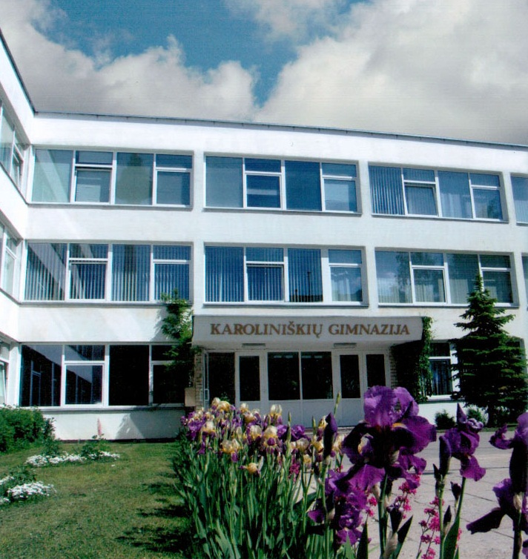
Welcome to my school – Vilnius Karoliniškės gymnasium.

Slide 3
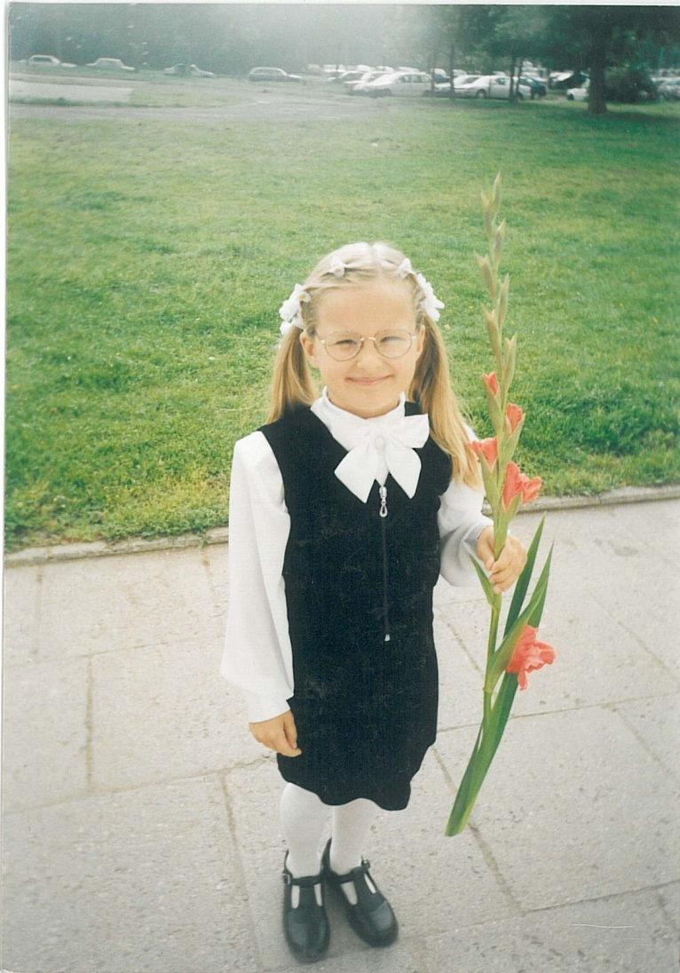
I have been studying here since I was six, back then, when our school had first graders, and have never felt sorry for my decision not to change school.

Slide 4
Since I know the school like the back of my own hand, I’ll throw you a quick tour of the school and briefly tell you about our daily life here.

Slide 5
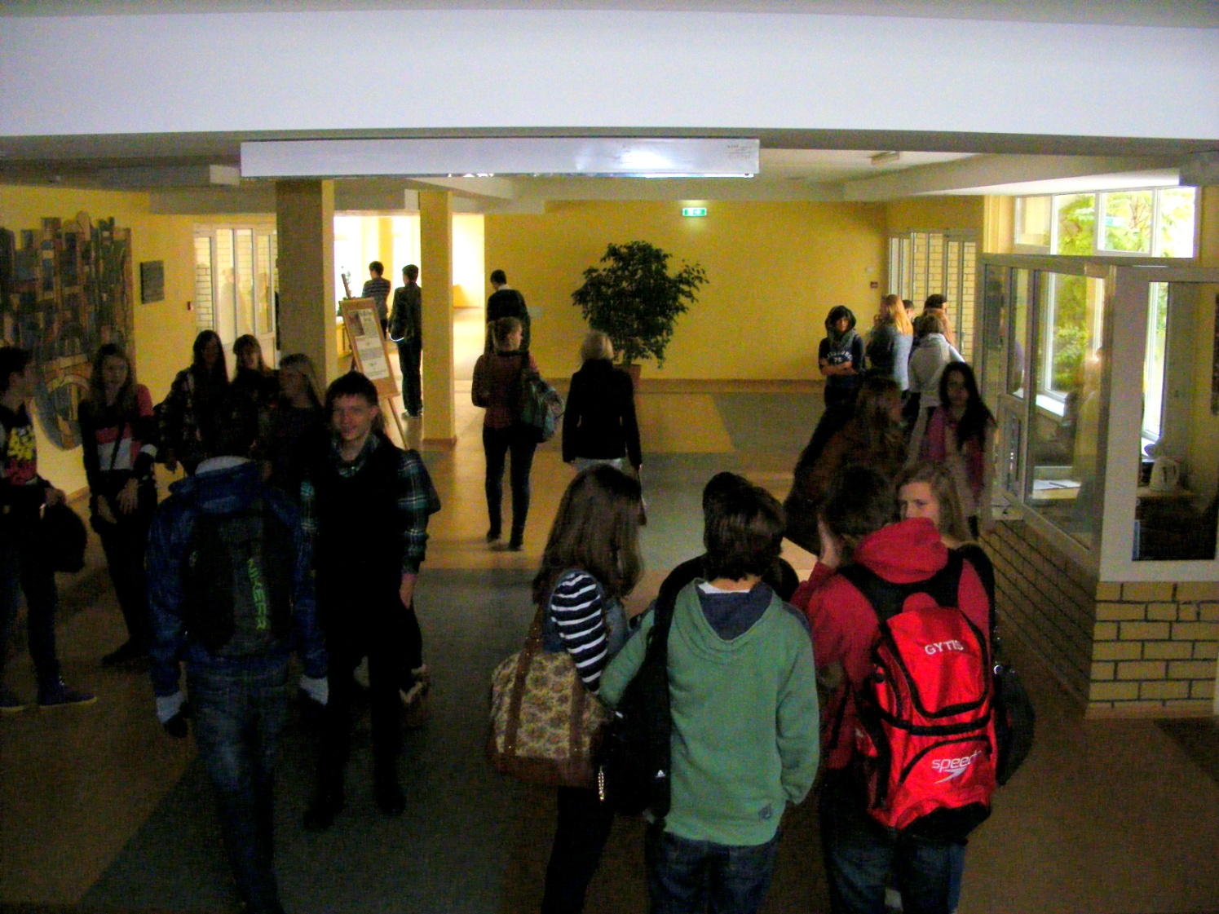
It all begins here, when I open the street-door and find myself in the main foyer.

Slide 6
It’s about 7:50 am. I pass a few familiar faces, hang my coat in the locker-room and have a quick chit-chat with my friends.

Slide 7
At 8 am the bell rings. That’s the announcement that the first lesson is about to begin. I rush into one of many classes and take a seat.

Slide 8
It doesn’t matter if it’s History, English, Physics or Math, the teachers here are always willing to help and guide us, and somehow classes never seem to get boring here.

Slide 9
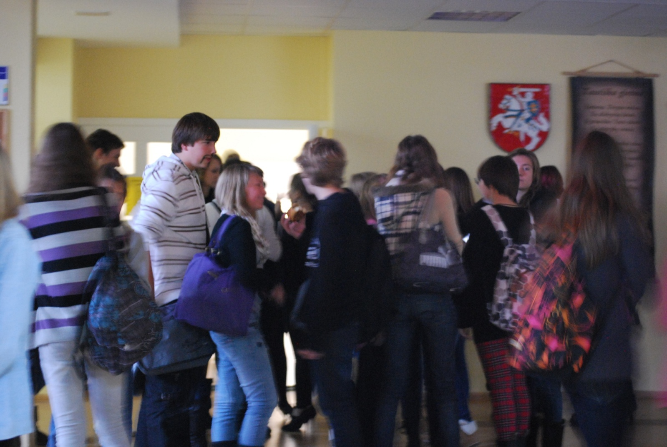
After 45 minutes, which is the duration of all periods, we have a 10 minute break.

Slide 10
Certainly, a 10 minute recess is far too short for us to grab a snack or repeat the material for the next class. That’s why after the second and fourth lessons we have longer breaks of 20 minutes.

Slide 11
What do we do during these long breaks?

Slide 12
Some of us study, read books at the library or the reading-room...

Slide 13
...others go to have lunch at the school cafeteria or just go wandering on the school terrain...

Slide 14
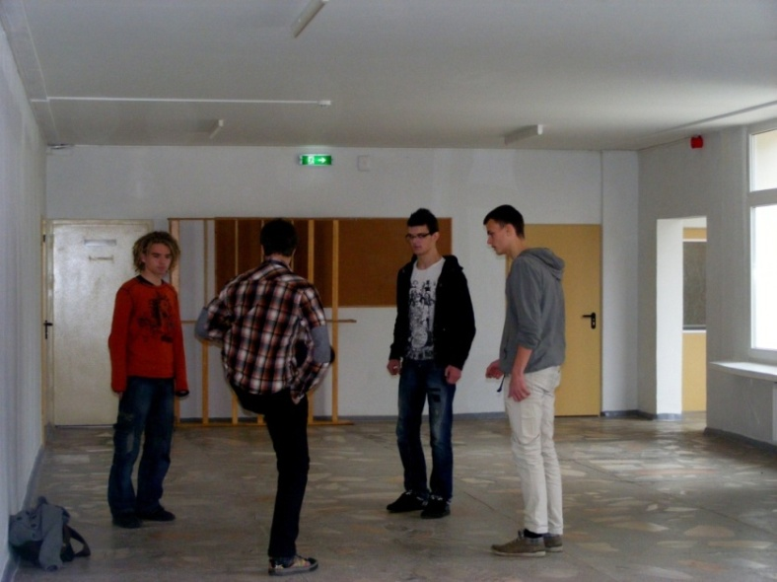
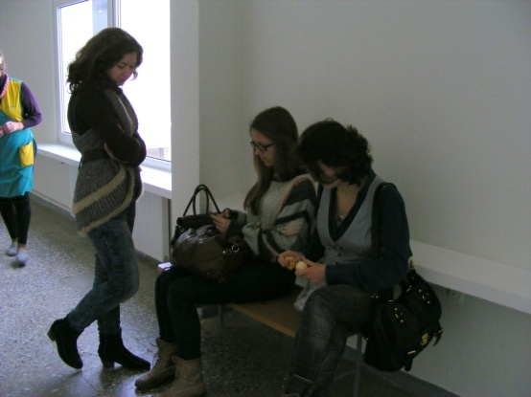
...but most of the students interact with each other in small groups or play group games.

Slide 15
Each day we have from approximately 6 to 8 classes, the amount of periods we have depends on the individual schedule made by the school council.

Slide 16
Sometimes we have spare periods which we call “windows”. On these classes we are free to do whatever we want – meet friends, go to a shop, do homework, listen to music, etc.

Slide 17
Of course there are days when the school routine changes and the daily life becomes wild and crazy – we organize the consecrations of the ninth graders, the teacher’s days, art days and a very special annual talent show “Virusas” (Virus).

Slide 18
Senior students at the consecrations of the ninth graders

Slide 21
And believe me, here at Vilnius Karoliniškės gymnasium we do have a lot of these festive days.

Slide 22
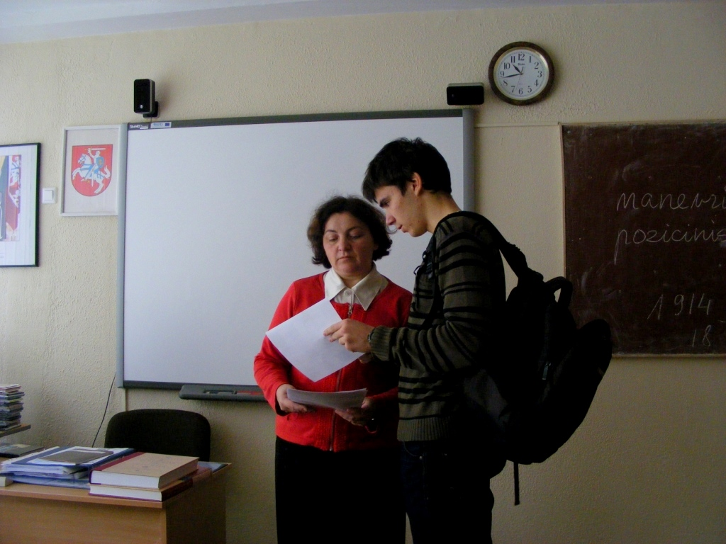
As a senior student I can say that the days here can pass at a speed of light because of many activities we’re involved with.

Slide 23
These activities include dance and aerobics classes, IT classes, music and art classes, science and language classes, and many more.

Slide 24
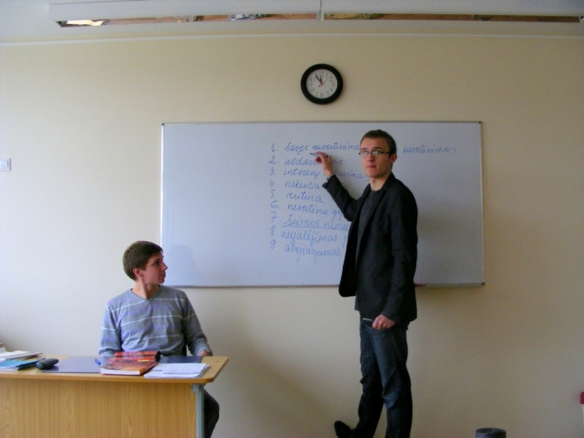
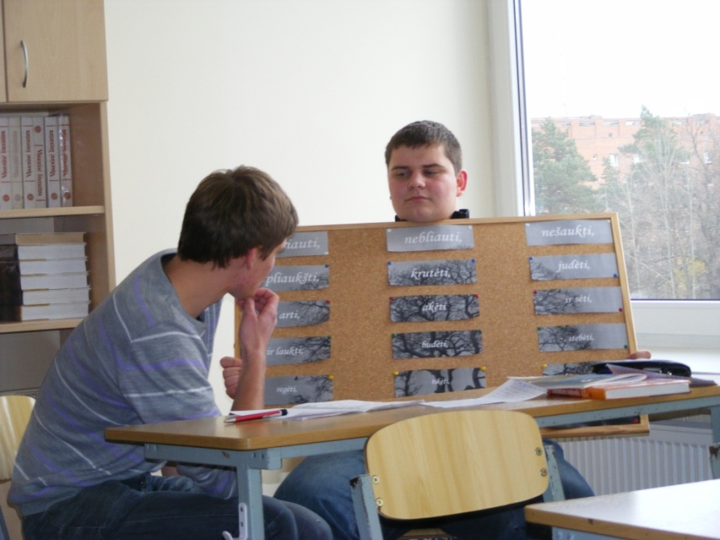
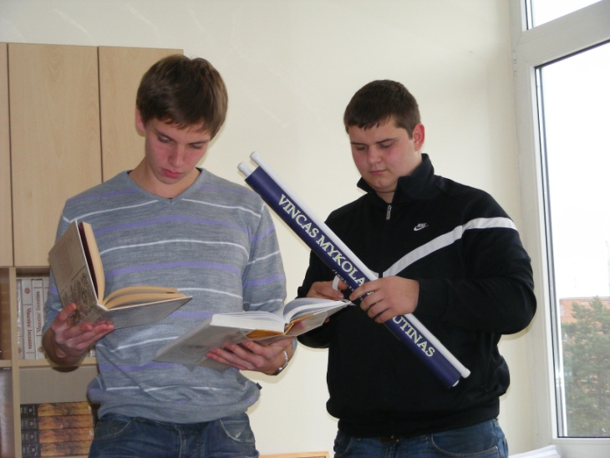

Slide 25
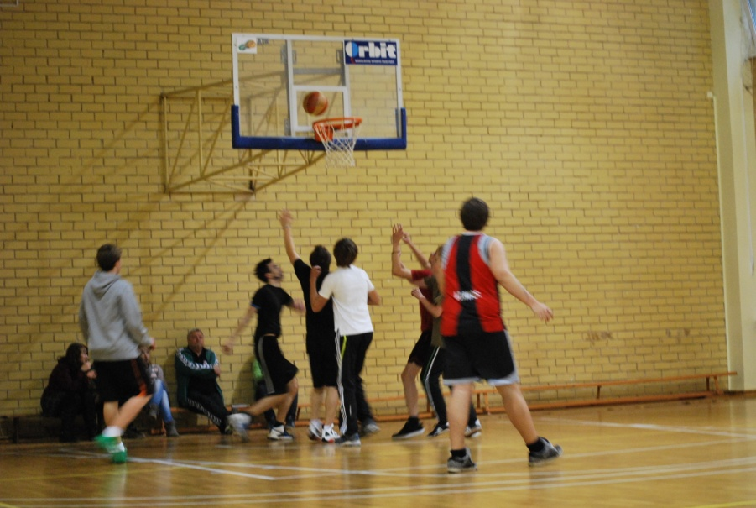
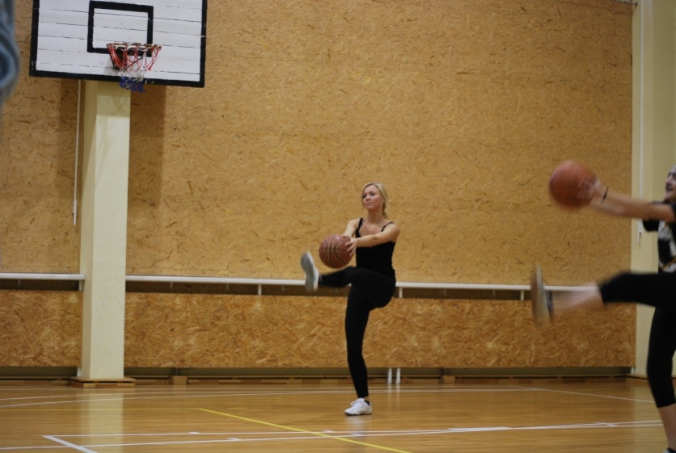

Slide 26
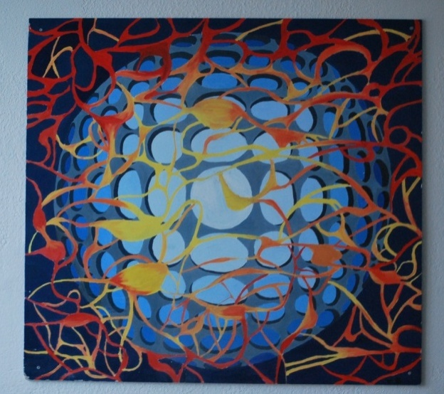
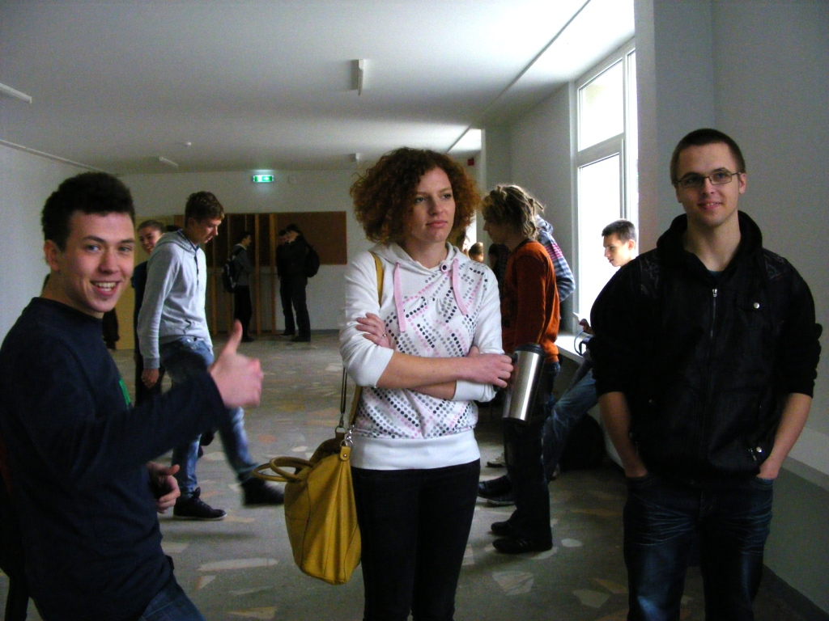
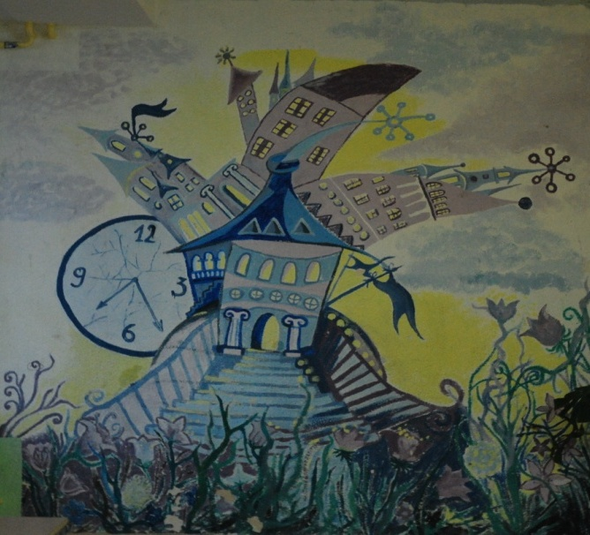
The atmosphere at our school is warm and friendly, we always welcome newcomers with tolerance and anticipation.

Slide 27
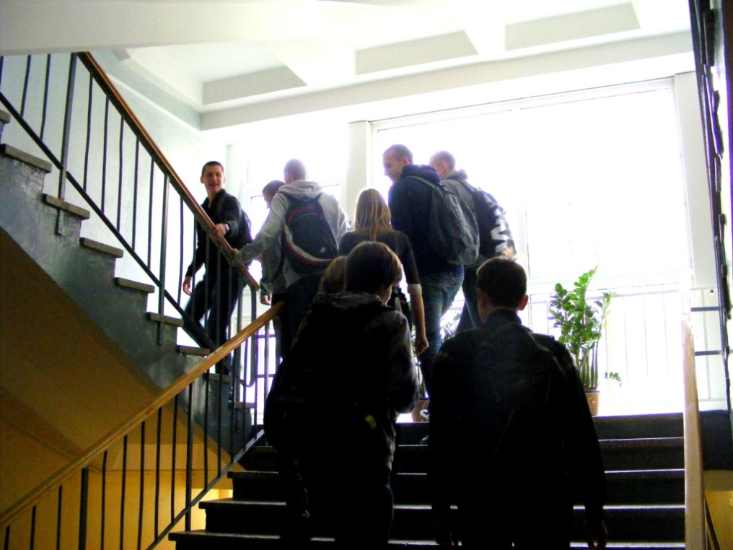
So, as the day passes, at about 14:35 the bell rings for the last time, announcing that my school day has already come to an end.

Slide 28
I grab my coat from the locker-room, say goodbye to the attendant and rush through the foyer right to the main door. The door quickly swings behind me and I’m free to go home.

Slide 29
Here’s a school promoting video, that depicts our daily life here.

Slide 30
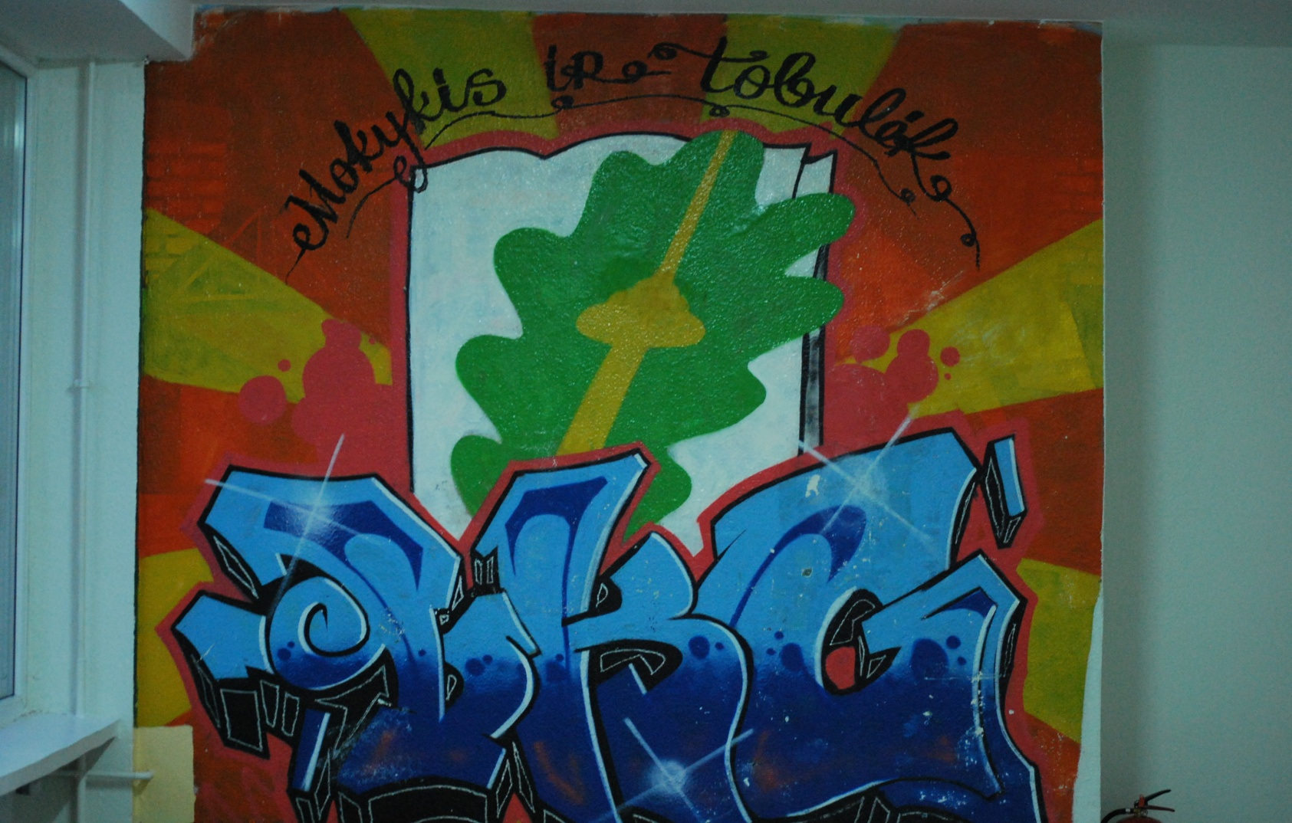
That’s the end of our little tour of Vilnius Karoliniškės gymnasium.

